Slide 1
CASTING: Pattern & Allowances
Lecture 2

Slide 2
Casting
It is the process of producing metallic parts by pouring a molten metal in to the mould and allowing the metal to solidify.

Slide 3
Casting Process
Mould is prepared
Metal is Heated above Melting Point Temp
Liquid Metal is Poured into Mold
Metal Solidifies into Shape of Mold
Casted Part is Removed from Mold
Post Casting Operations
Cutting
Clean Up
Machining

Slide 5
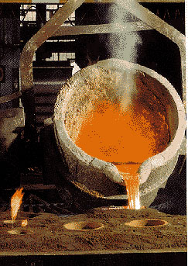

Slide 6
Pattern
A pattern is a replica of a casting to be made.
Using pattern, impressions (mould cavity) can be formed in the damp sand to make a mould.

Slide 7
Pattern materials
Wood: easy to work & readily available, can be cut in to required shapes and used when small number of castings
Metal: do not change their shape when subjected to moist condition, used when small number of castings
Plastics: do not absorb moisture, smooth, can be withdrawn from the mold easily, without damaging the mold
Plaster: High compressive strength

Slide 8

Green sand mold
with pattern
Drag
Drag
Drag
Drag
Pattern
Pattern
Molding board
Molding board
Molding board
Molding board
FIRST OPERATION
FIRST OPERATION
Vents
Weight
Lifter
Riser pin
Sprue pin
Pouring basin
Cope
Riser
Parting
line
Parting
line
Runner
Gate
Core
SECOND OPERATION
COMPLETE MOLD

Slide 9
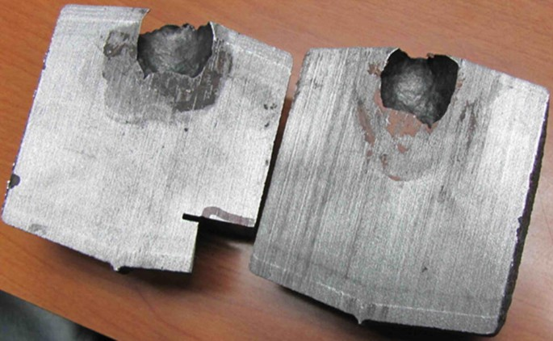
Casting Defect

Slide 10
Types of patterns
1. Single piece pattern 2. Match plate pattern
3. Gated pattern 4. Split pattern
5. Cope & Drag pattern 6. Loose-piece pattern
7. Skeleton pattern

Slide 11
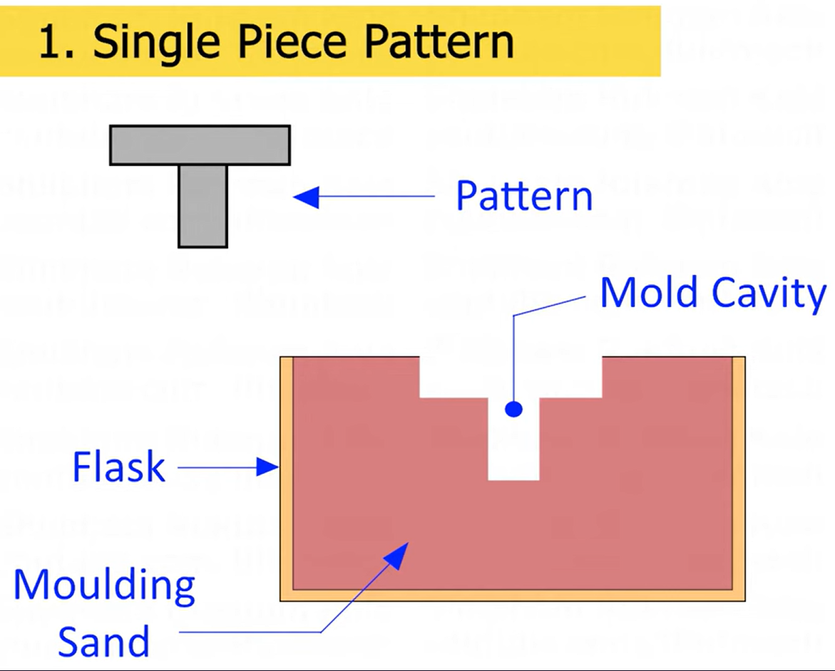
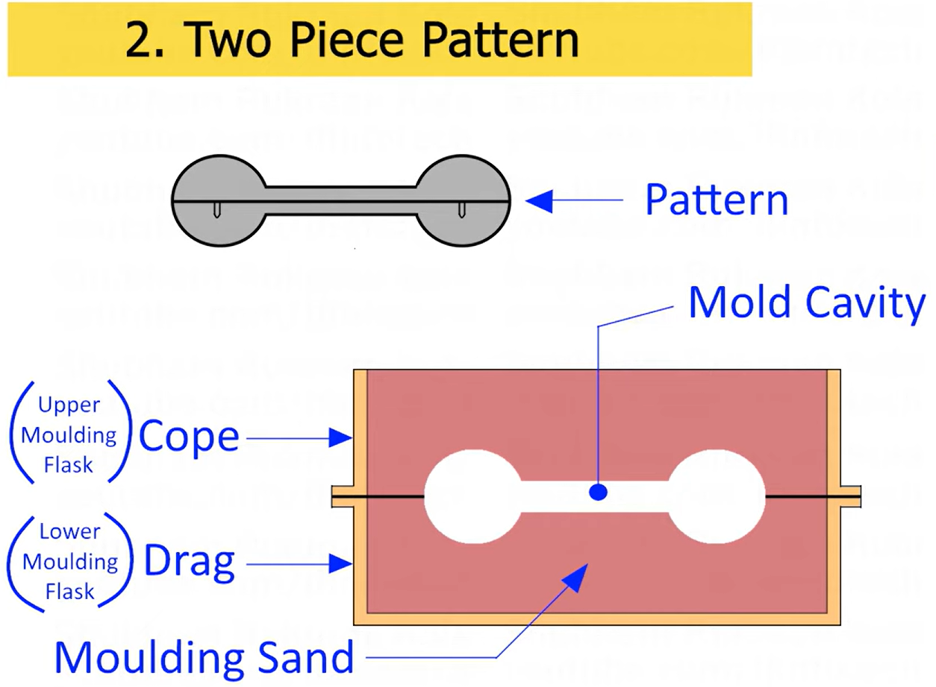
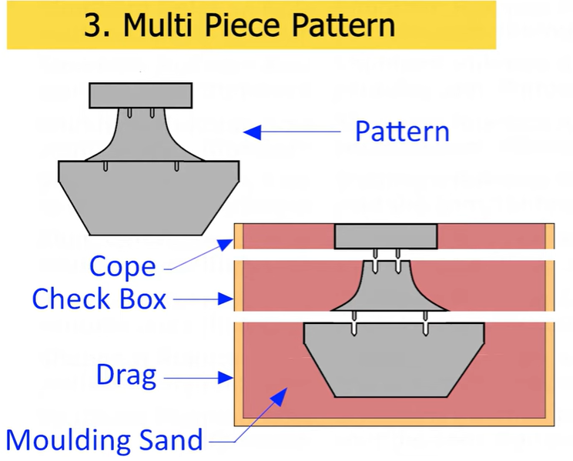
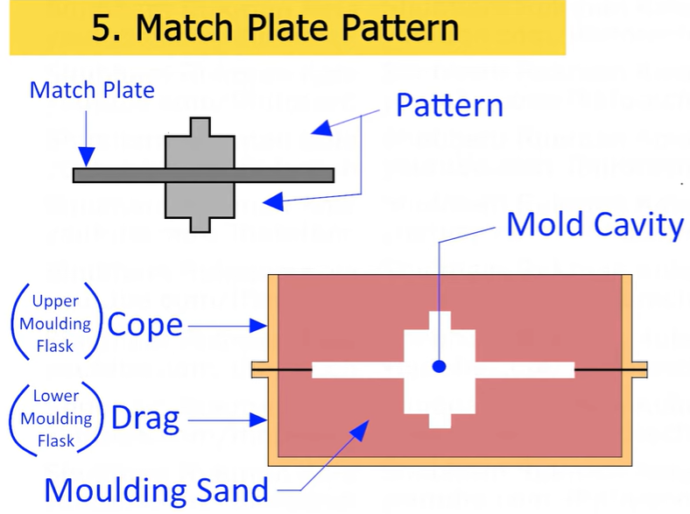
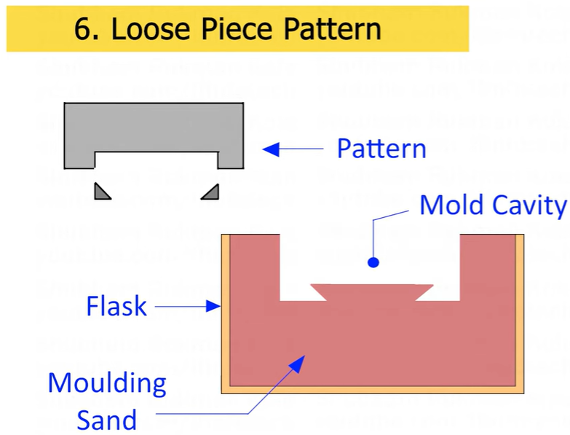
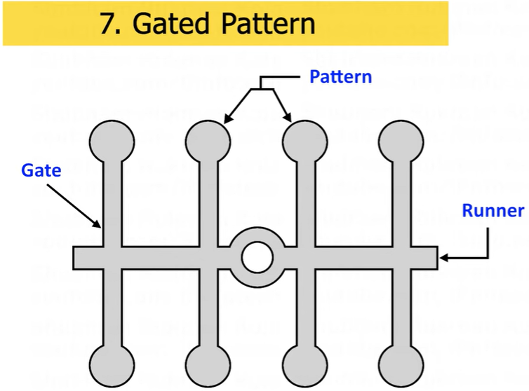
Types of patterns

Slide 12
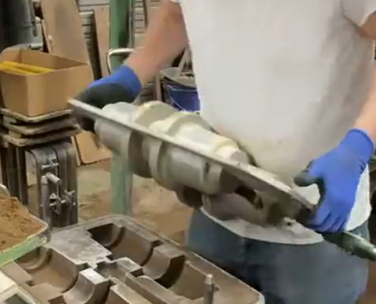
Match Plate Pattern

Slide 13
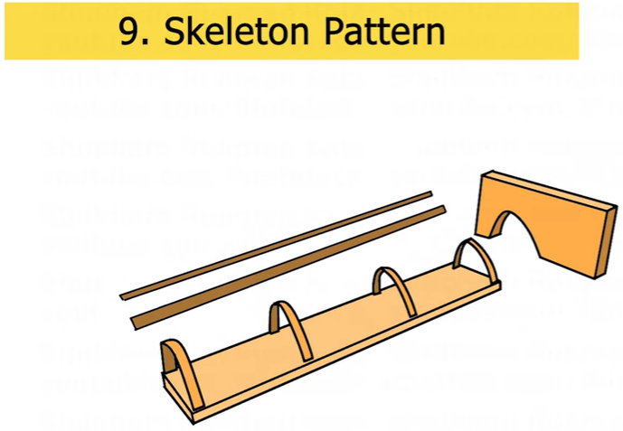
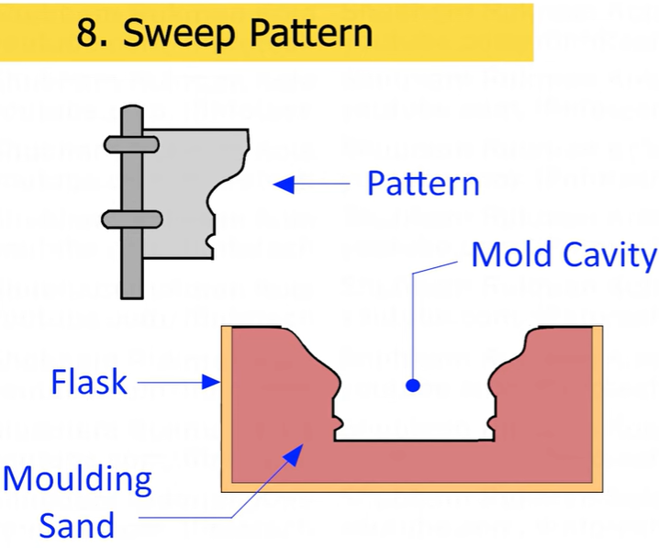
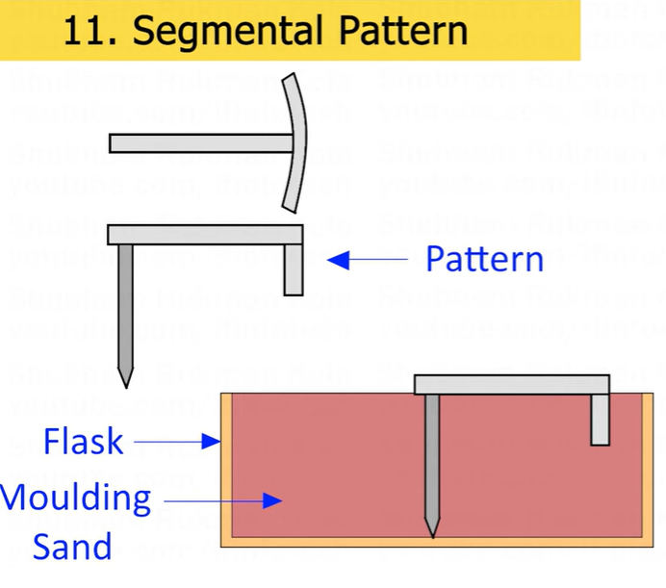
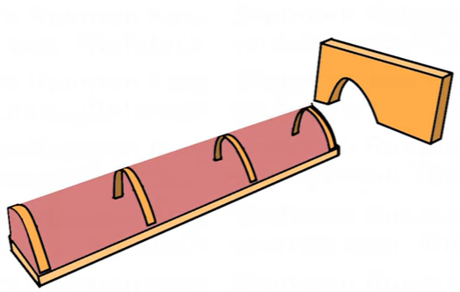
Types of patterns

Slide 14
Types of patterns
Single piece pattern
Made from one piece & does not contain loose pieces
Inexpensive & are of simplest type
Split pattern
Most widely used pattern for intricate castings
Here the pattern is split into 2 parts so that one part is in
the cope & other is in the drag
Two halves of the pattern is aligned properly by using
dowel pins

Slide 15
Cope and Drag pattern
Similar to split patterns
The cope & drag halves of the pattern along with the gating
and riser systems prepared separately
But they are attached separately to the metal or wooden
plate along with alignment pins
Match plate pattern
An extension of cope and drag pattern
Here the cope & drag patterns along with the gating &
risering are mounted on a single matching or metal plate
on either side

Slide 16
Loose piece pattern
Used when contour of the part is such that withdrawing the pattern from the mold is not possible
Obstructing part is held as a loose piece
Skeleton pattern
Made of strips of wood for preparing final pattern
by pouring the sand around the pattern and packing it

Slide 17
Gated pattern
Usually made of metal which increases their strength and reduces tendency to warp
Section connecting different patterns serve as runner and gates
A gated pattern can manufacture many castings at one time
Used in mass production systems

Slide 18
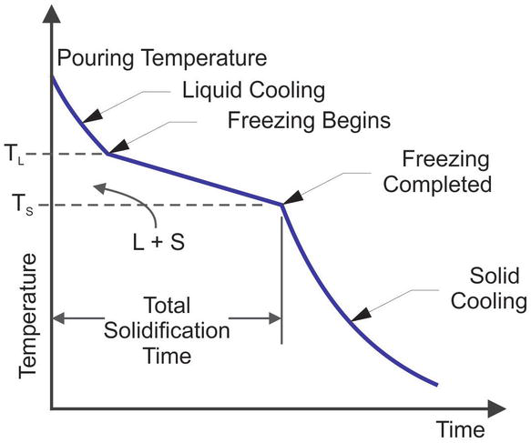
Molten Metal Cooling Curve

Slide 19
Pattern Allowances
Shrinkage allowance
Draft or Taper allowance
3. Machining or Finishing allowance
4. Camber or distortion allowance
5. Shake or Rapping allowance

Slide 20
Pattern Allowances
Shrinkage allowance
Most of the metals used in casting contract during cooling from pouring temperature to room temperature
Provided to compensate for solid contraction by providing adequate allowances in the pattern
Amount of contraction varies with different metals

Slide 21
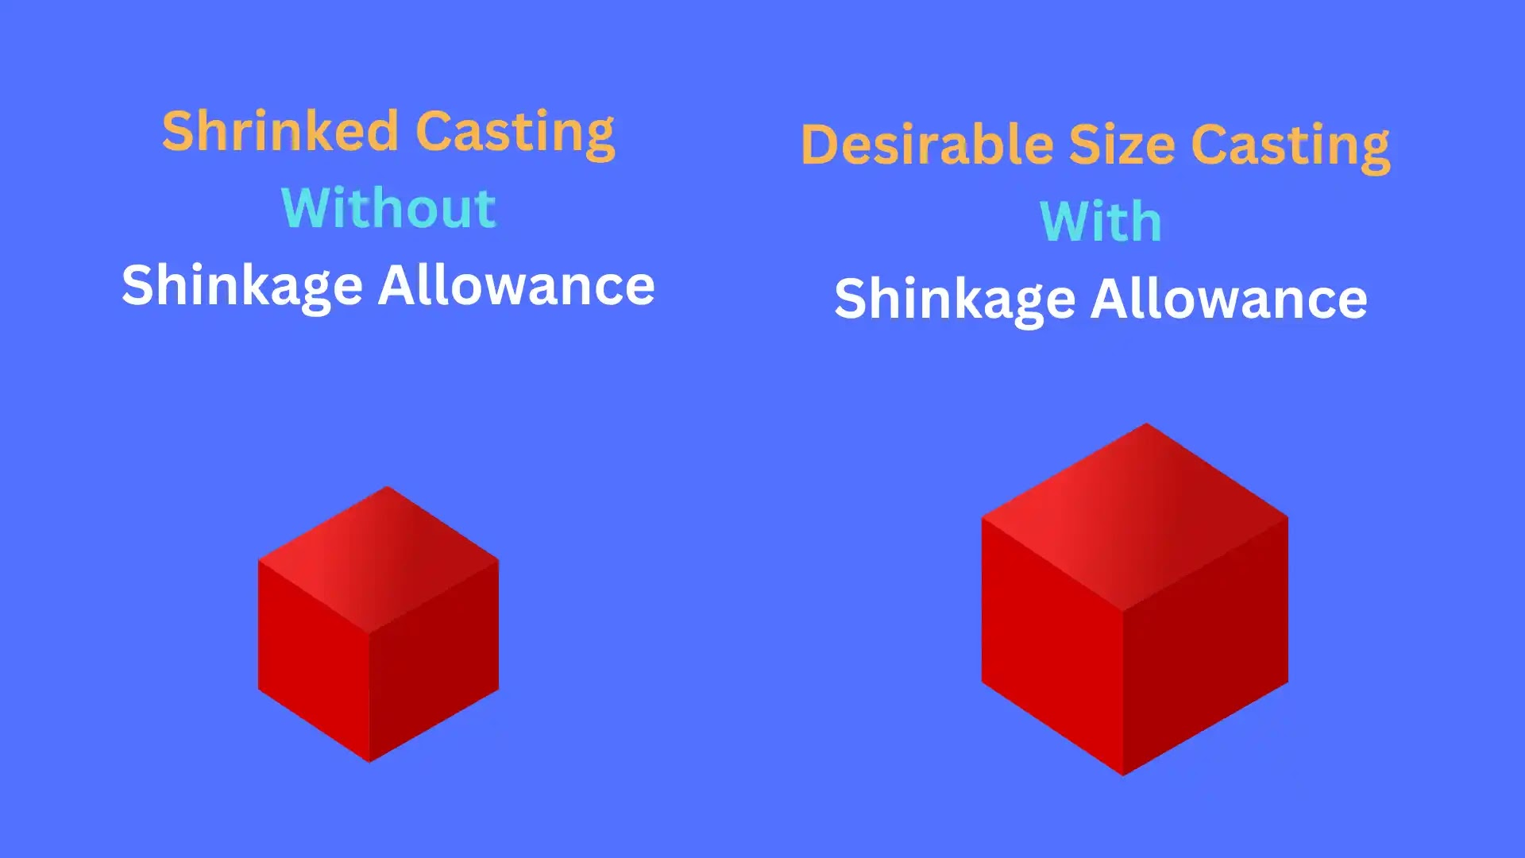
Pattern Allowances
Shrinkage allowance

Slide 22
Pattern Allowances
2. Machining Allowance
Given on the surface of the pattern by increasing the metal
thickness there to compensate for loss of metal due to
machining on these surfaces
Depends mainly upon method of machining to be employed
Given in addition to the shrinkage allowance

Slide 23
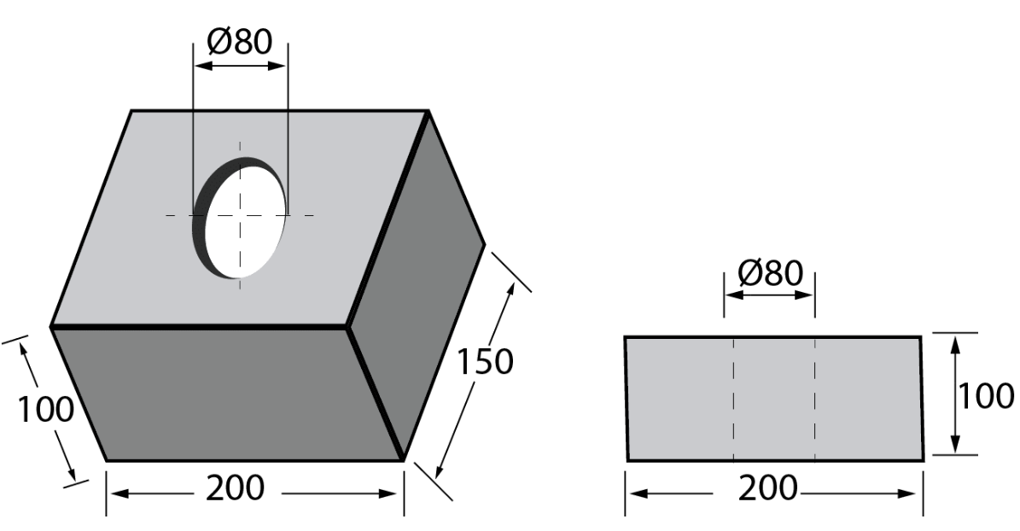
Pattern Allowances
Machining Allowance

Slide 24
Pattern Allowances
3. Draft or Taper allowance
Given slight taper on the vertical surfaces of the pattern
parallel to the direction of withdrawal from the mould
Provided on both internal & external surfaces
For easy withdrawal of pattern from the mould

Slide 25
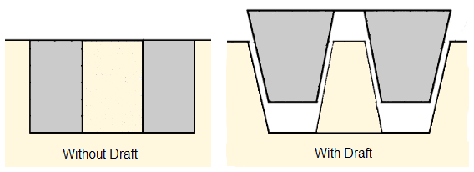
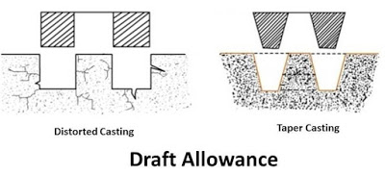
Pattern Allowances
Draft or Taper allowance

Slide 26
Pattern Allowances
4. Rapping allowance
Negative allowance to be provided in the pattern
When pattern is withdrawn from the mould by striking over
it from side to side, size of the cavity increases
To compensate this rapping allowance is provided

Slide 27
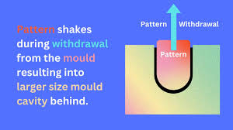
Pattern Allowances
Rapping allowance

Slide 28
Pattern Allowances
5. Distortion allowance
Castings having irregular shape, will not have uniform
contraction during their cooling
Results in distortion of the castings
Remedy:
An opposite distortion is provided in the pattern

Slide 29
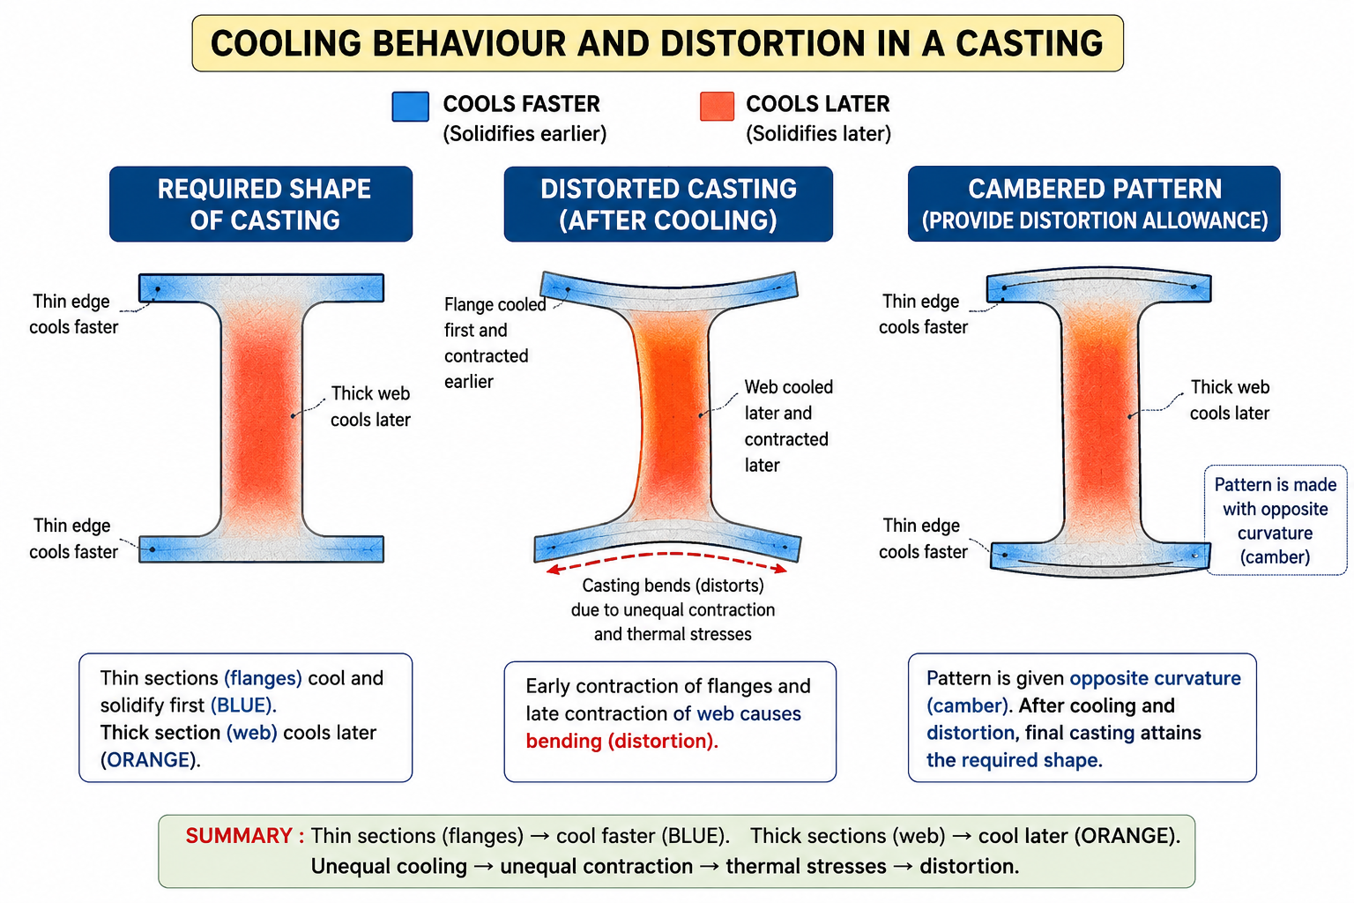
Pattern Allowances
Distortion allowance

Slide 30
11

Slide 31
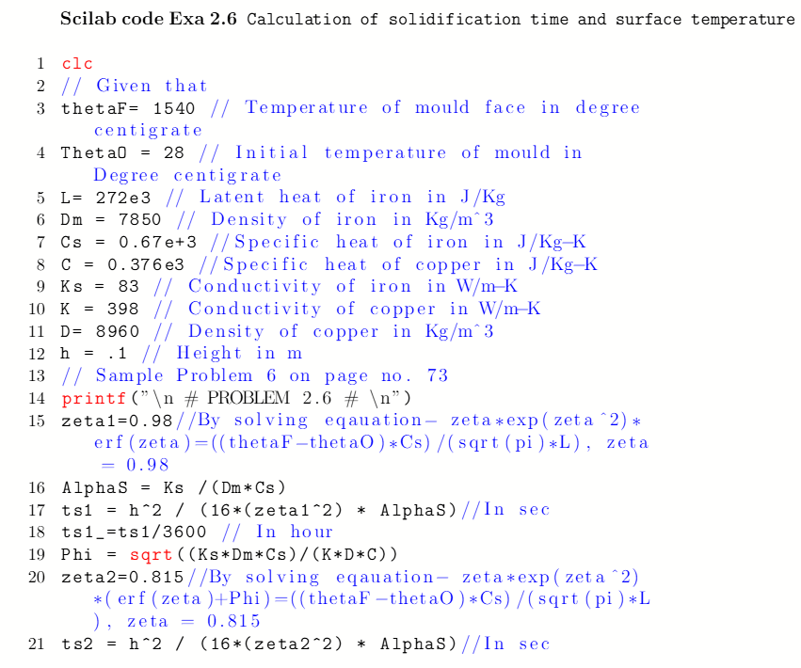

Slide 32
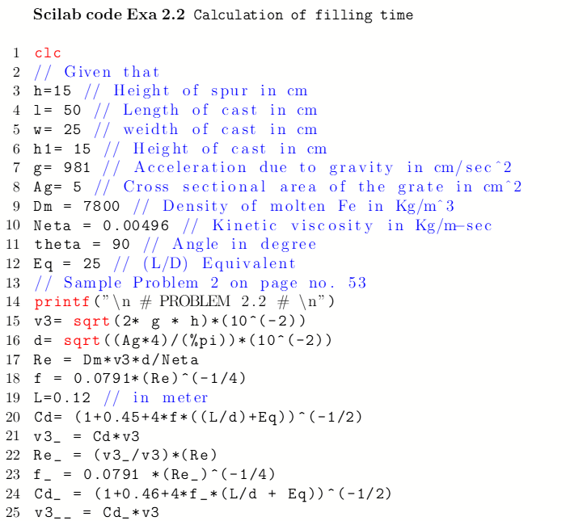

Slide 33
